Slide 1
The male reproductive system
Dr. Alaa Hussein Sadoon
The male reproductive organs include
1- paired testes, which produce both male gametes (sperm) and hormones
2- paired gonadal duct systems, each consisting of an epididymis and deferent duct (ductus deferens),which convey the exocrine products of the testes to the urethra
3- suite of accessory glands, which contributes the bulk of the semen

Slide 2
4- male urethra, which extends from the bladder to the free extremity of the penis and serves for the passage of both urine and semen.
5- The penis, the male copulatory organ, which deposits the semen within the reproductive tract of the female.

Slide 3
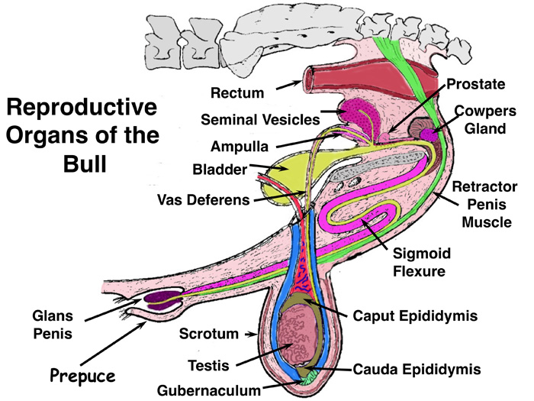

Slide 4
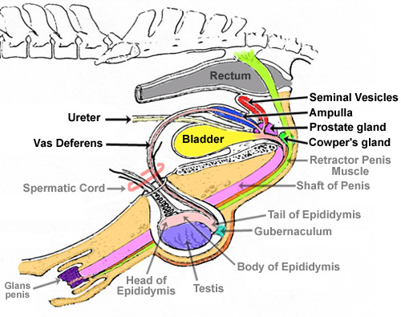

Slide 6
The Testis
The testis combines endocrine and exocrine components within a common capsule. The endocrine component functions normally at the core temperature of the body, but in most mammals the successful production of the male gametes requires a temperature a few degrees lower than that within the abdomen. Hence, although the testes develop within the abdomen, they later migrate, descending through the inguinal canals to come to lie within the scrotum canals to come to lie within the scrotum ( a pouch of skin and underlying fasciae variously placed between the thigh and perineum) .

Slide 7
The testes are solid , ellipsoidal organs whose bulk bears no fixed proportion to the body size. Among domestic species they are small in cats and large in sheep and goats. Their orientation also varies. They are carried with their long axes , vertical in ruminants , horizontal in horses and dogs, and tilted toward the anus in pigs and cats. These differences are broadly correlated with the position of the scrotum, which is below the caudal part of the abdomen in ruminants, perineal in pigs and cats, and intermediate in position in horses and dog ..

Slide 8
Each testis is separately suspended within the scrotum by a spermatic cord, a bundle of structures that includes the deferent duct and the supplying vessels and nerves enclosed within a double covering of peritoneum .
The outer surface of the testis is made smooth by the direct peritoneal investment, except at the poles and along one margin where the testis is attached to the Epididymis.

Slide 9
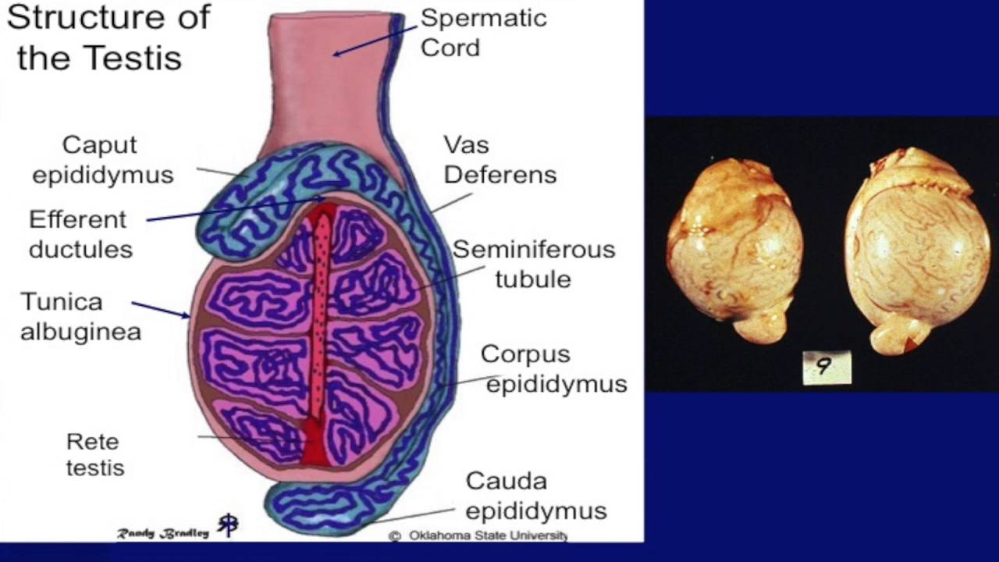
The peritoneum covers a thickest capsule (tunica albuginea) mainly composed of dense connective tissue but sometimes including smooth muscle. The capsule detaches septa and trabeculae that divide the parenchyma into lobules. The septa converge on a substantial thickening ( تلتقي بكثافة ) AT mediastinum testis; this may be axial or displaced toward the side bordering the epididymis.

Slide 10
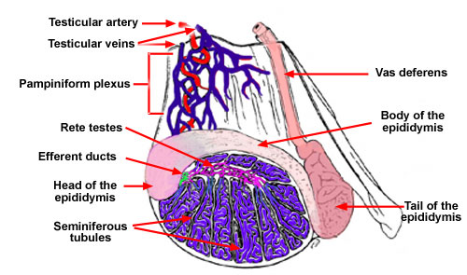

Slide 11
The soft, yellowish or brownish parenchyma consists of intermingled seminiferous tubules and interstitial tissue , that consist of interstitial (Leyding) cells .
.The interstitial cells are the principal producers of the steroid androgenic hormones.
Each seminiferous tubule open at rete testis a plexus of spaces within the mediastinum. Within the seminiferous tubules, two cell types can be discerned: the Sertoli cells, which support and nourish the germ cells by the production of hormones and growth factors, and the seminiferous epithelium . The rete drains by a dozen or so efferent ductules that pierce the capsule to join the head of the epididymis.

Slide 12
2- The epididymis :
The epididymis is a firm organ that is largely formed by the numerous convolutions of the single epididymal duct within a connective tissue matrix. It is attached along one of the longer borders , it is dorsal in the dog, caudomedial in the bull of the testis and usually spreads some distance over both poles.

Slide 13
It is divided into three parts—head, body, and tail.
The head , is firmly attached to the testicular capsule. It receives the efferent ducts , which is coiling and forming epididymal duct . The body may be less completely attached to the surface of the testis. The tail is firmly attached to the testis by a ligament . The tail finally tapers, and the duct emerges to continue as the deferent duct .

Slide 14
3 - THE DEFERENT DUCT
The deferent duct firstly runs medial to the epididymis as it heads toward the testicular vessels that form the great components of the spermatic cord. The constituents of the cord remain together as they pass through the inguinal canal but disperse(تتفرق ) at the vaginal ring. The duct here turns caudomedially to pass under the ureter before gaining the dorsal surface of the bladder , it penetrates the prostate before finally entering the urethra .

Slide 15
In most species the sub terminal stretch lying on the bladder exhibits a fusiform enlargement, the ampulla of the deferent duct or ampullary gland , this suggests a widening of the lumen, the thickening is mainly due to glandular proliferation in the wall of the duct. In most domestic mammals a second accessory gland grows from the duct close to its termination. This, the known as the ejaculatory duct.
In pig The deferent ducts take their usual courses to penetrate the body of the prostate before opening into the urethra on the summit of a low papilla . They do not expand to form ampulla.

Slide 16
THE SPERMATIC CORD
The spermatic cord consists of the structures carried down by the testicle in its migration through the inguinal canal from the abdominal cavity to the scrotum. It begins at the internal inguinal ring, where its constituent parts come together. It consists of the following structures :(1) The spermatic artery.
(2) The spermatic veins, which form plexus around the artery.
(3) The lymphatics, which accompany the veins.

Slide 17
(4) Sympathetic nerves, which run with the artery.
(5) The vas deferens.
(6) The internal cremaster muscle
(7) The visceral layer of the tunica vaginalis or mesorchium

Slide 18
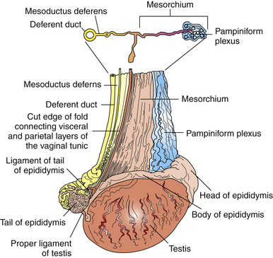

Slide 19
The Scrotum
Variations in the location and form of the scrotum have been noted . Externally, a median groove marks the division into right and left compartments. The lower part of the scrotum is molded on the testes. The relatively thin scrotal skin is well provided with both sweat and sebaceous glands.

Slide 20
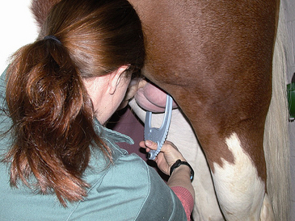
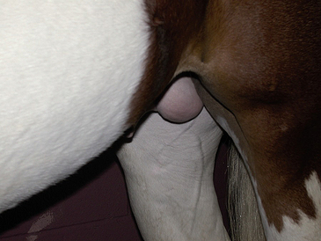

Slide 21
REST

